Slide 2


Security Control Compliance Server
Ending Medieval Compliance
Greg Elin| GovReady PBC | @govready
January 9, 2019

Slide 3


Team Profile
Greg Elin
Founder, ex-Chief Data Officer of FCC
Dr. Joshua Tauberer
CTO, Creator GovTrack.us and Linguistics PhD

Slide 4


Customer Need: Compliance Age of Enlightenment
NIST Risk Management Framework was created…
Before the Cloud
Waterfall was dominant
Dev/Ship was 12 – 18 months
Modern cloud-first IT needs…
faster ATOs (ATO-in-a-Day)
continuous authorization
reuse and sharing

Slide 5
Approach: Enlightenment = Compliance as Code
Configure by Hand
Configure by Code
Type: Linux
CPUs: 2
Size: 32GB
Storage: 80GB
Config: Database
ENLIGHTMENT
SSP, ATO Package, …
Type: Linux
CPUs: 2
Size: 32GB
Storage: 80GB
Config: Database
Database
Security Plan

Slide 6
Approach: Compliance as Code
helps give system
Component X
Controls (AC-02, AC-03, …)
Extend control inheritance to all system “components”
Store component-control maps as data in a library
Automate library lookup and creating draft SSP
Use APIs, DevSecOps to continuously assess predefined evidence
Do Not Distribute

Slide 7
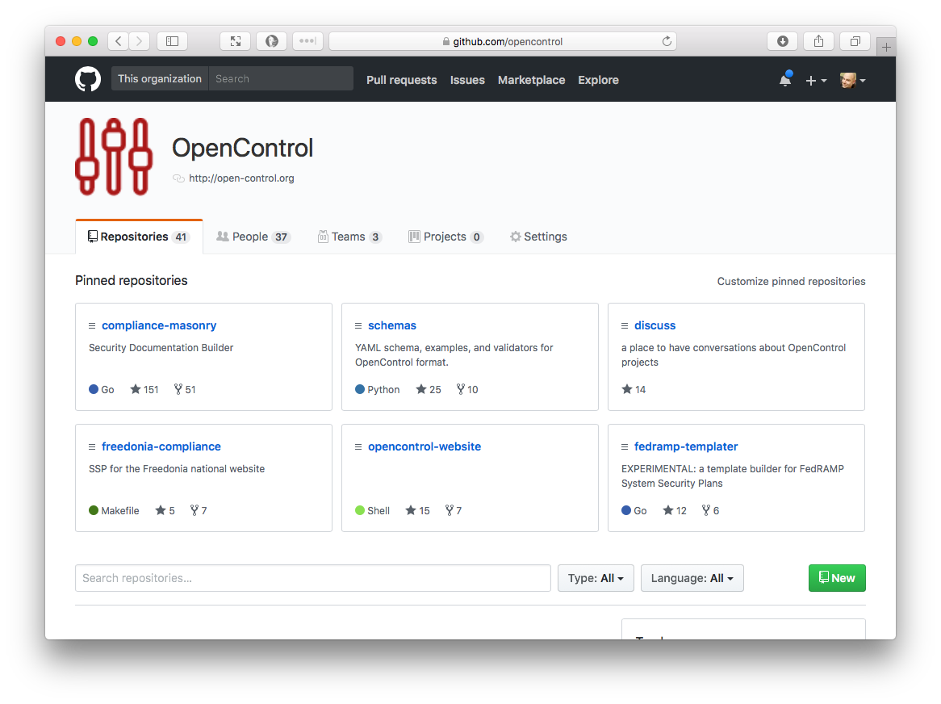
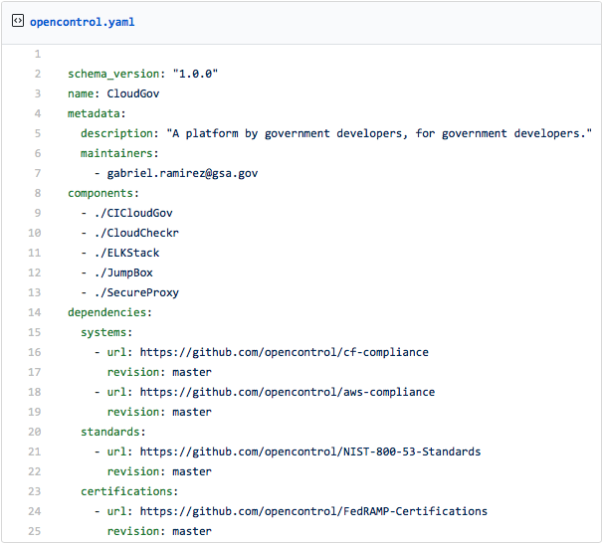
Approach: OpenControl Data Spec
Compliance Supply Chain
Pre-written control narratives
Pre-defined evidence types
Pre-defined testing routines

Slide 8
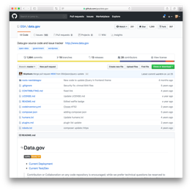
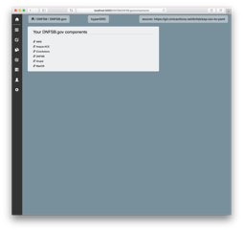
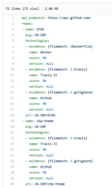
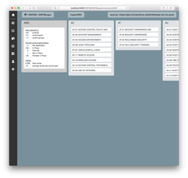
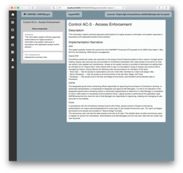
Benefit: Auto-generating Security Control Text
Step 1
Step 2
Step 3
Step 4
Profile System Source Code
Look up controls in Component Security Plan Library
Generate draft Security Control Text
Iterate and improve
CSP
Library

Slide 9
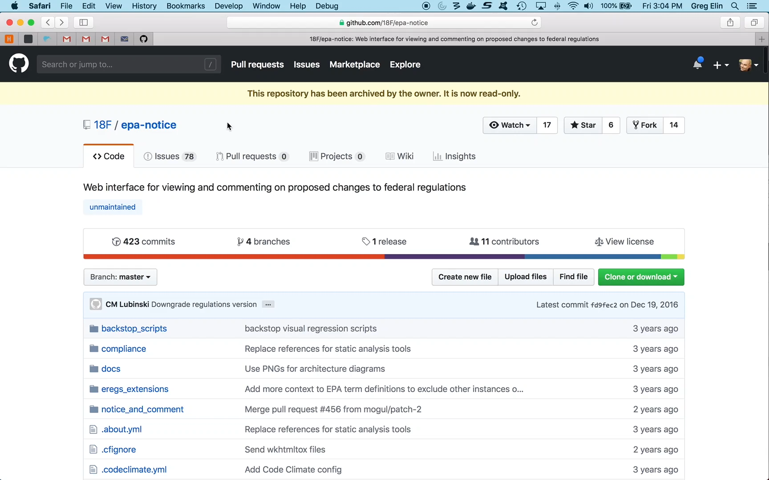
Notes:
Now let’s see what happens when a developer makes a change and builds a new version of our sample IT system. a simple target app and the see testing security in the pipeline, flowing the information into our compliance apps and the SSP. The result of our new scan, and the impact on compliance automatically flows through the compliance apps and updates our SSP. (Do demo.)

Slide 10
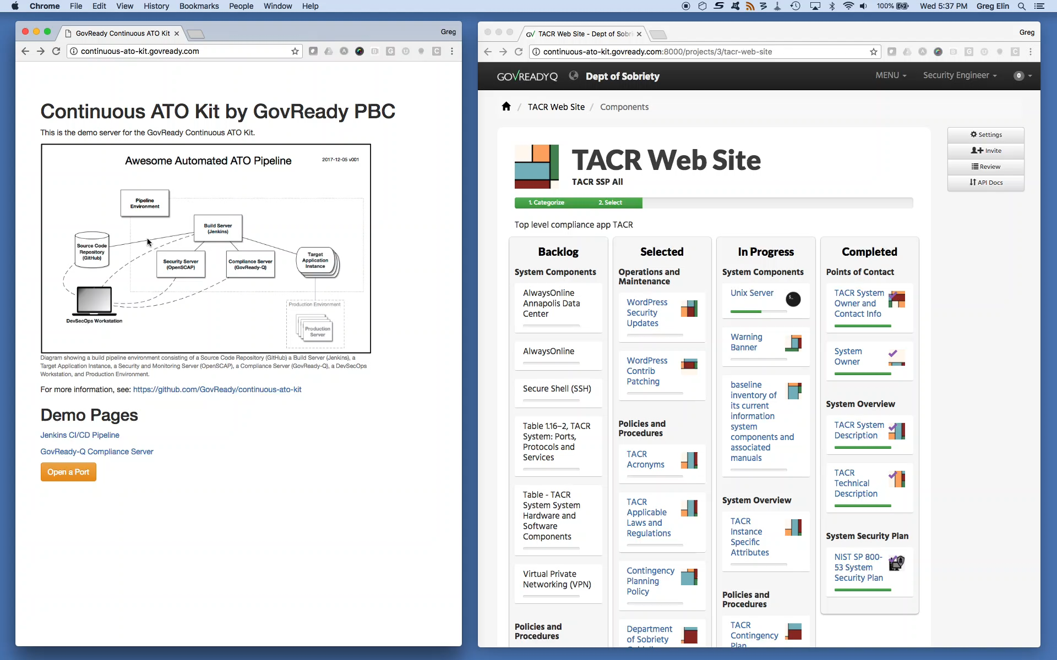
Notes:
Now let’s see what happens when a developer makes a change and builds a new version of our sample IT system. a simple target app and the see testing security in the pipeline, flowing the information into our compliance apps and the SSP. The result of our new scan, and the impact on compliance automatically flows through the compliance apps and updates our SSP. (Do demo.)

Slide 11
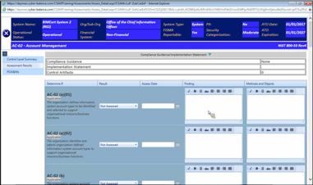
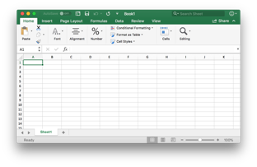
Competition/Alternatives
Medieval GRC Software & Consultants
Next-Gen Platforms (i.e. IBM Red Hat)
No DATA = No API = No Reuse
Compliance as Code with Lock-in

Slide 12



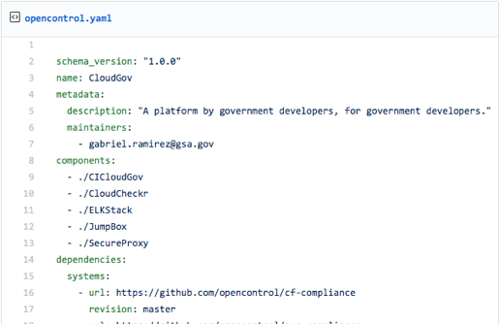







Current Status–Compliance-as-Code Adoption
ENLIGHTMENT
Most Agencies/Vendors
Early Adopters/Experimenters
Compliance as Code
*
NGA GEOINT
*
*
OSCAL
HHS OIG
*
*
*
*
*
*
*
Office of the Chief Technology Officer
*
*
Testing GovReady
DOJ USTP

Slide 13

Completion Activities - 2019
Creating More Component Security Plans
Improving Data Standard (OpenControl, OSCAL)
Pilots and Improvements
Enterprise Software Integration

Slide 14
Lessons Learned
What Didn’t Work
What Worked
Cloud = “shared responsibility,” not “fewer controls”
LEAN thwarted by gov. latency
“Getting started” gaps
Needing multiple team buy-in
Assuming culture of sharing
Component Security Plans thinking
Perseverance: 7 – 12 month cycles
Offering Professional services
Limiting sales meetings
Getting a DHS badge
Webinars and weekly practice demos

Slide 15


Ignore the haters, compliance!
Compliance is about having standards of excellence
Standards enable trust
Trust enables velocity and success

Slide 16

Contact Info
Greg Elin
GovReady PBC
gregelin@govready.com
917-304-3488
@govready

Slide 17
@govready

